Slide 1
Old Owens Cricket Tour St Lucia February 2024

Slide 2
Tour Proposal
Saturday 10th – Saturday 17th February 2024
7 nights @ The Bay Gardens Beach Resort, Rodney Bay (4*) – B&B Basis
4 Matches at mixture of grounds including 1 international venue
Cost: £1500-£1600 - Includes all flights/accommodation/transfers/fixtures - A few excursions/activities will be included - Evening meals will be at tourists cost

Slide 3
Proposed Itinerary

Slide 4
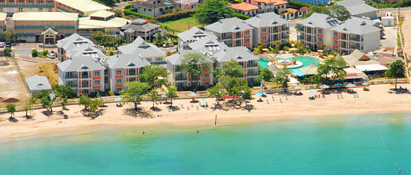
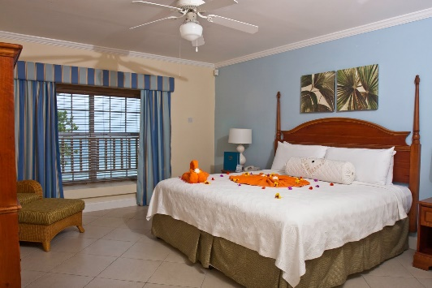
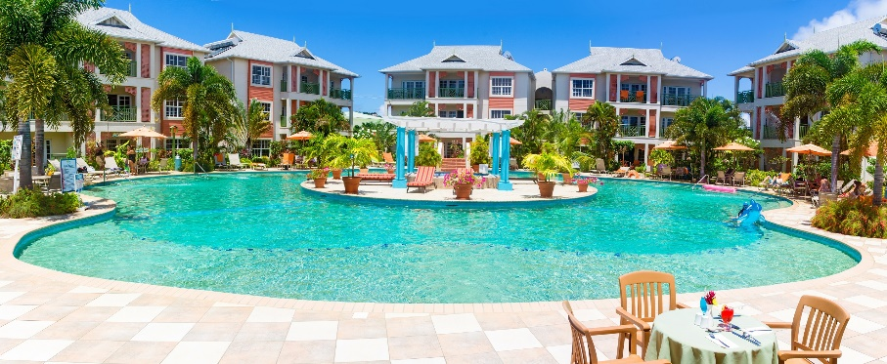
Day 1 – Saturday – 10/02/2017
Mid morning flight from Gatwick
Arrive at Hewanorra International Airport, St Lucia mid/late afternoon - 1 hour 30 minutes drive to Hotel
Check in to Bay Gardens Beach Resort, Rodney Bay
Relax/Evening Meal at Hotel

Slide 5
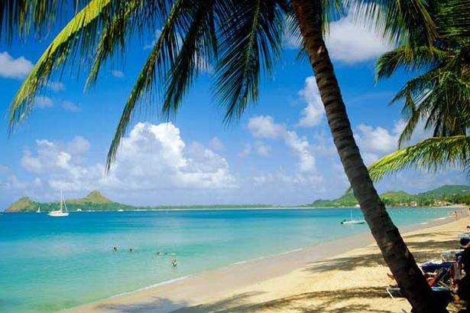
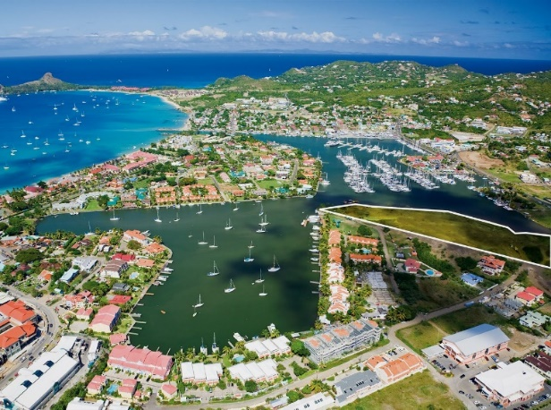
Day 2 – Sunday – 11/02/2017
Optional morning training session @ Gros Islet Cricket Club
Hotel Leisure
Pigeon Island National Park
Rodney Bay/Marina

Slide 6
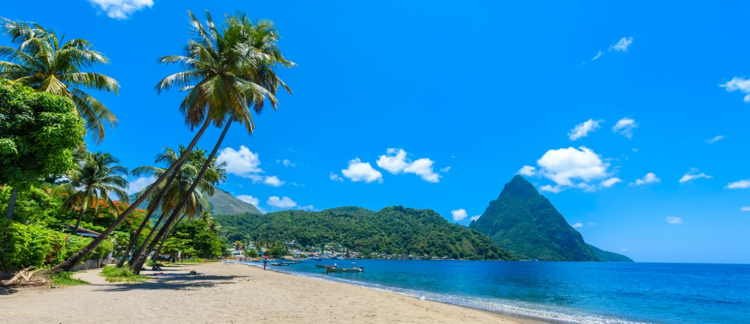
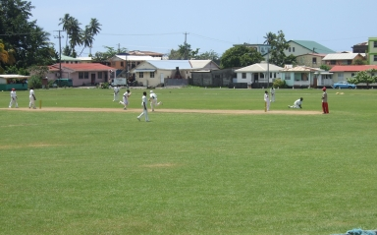
Day 3 – Monday – 12/02/2017
Match Day 1 @ Gros Islet Cricket Club
40/50 Over Game
Evening Meal at Restaurant

Slide 7
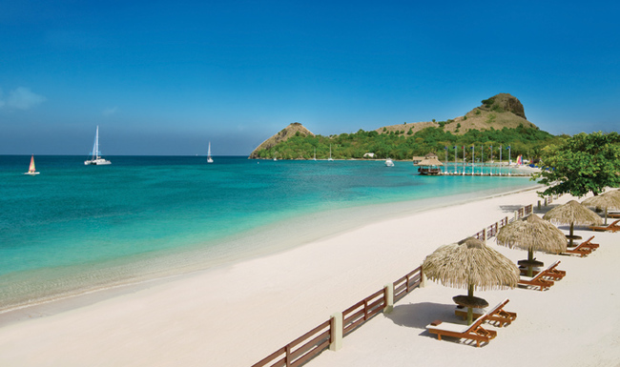
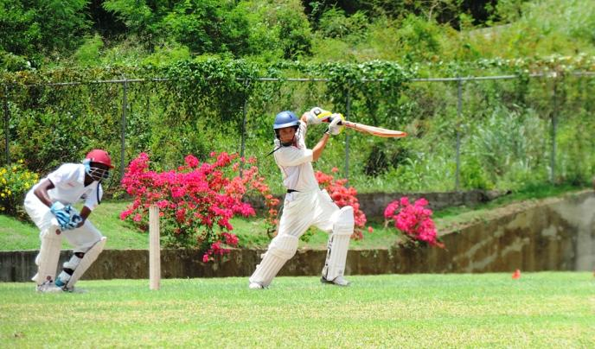
Day 4 – Tuesday – 13/02/2017
Match Day 2
40/50 Over Game
Evening Meal at Restaurant

Slide 8
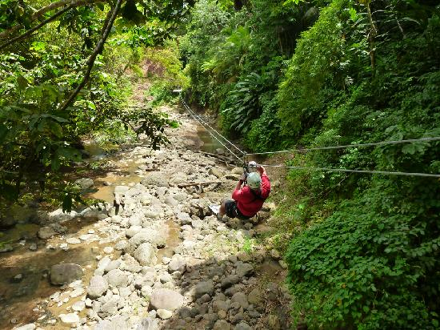
Day 5 – Wednesday – 14/02/2017
Optional Sightseeing/Activities in St Lucia - Island Adventure Tours - Treetop Zip Line Adventure - Island Buggy Tours - Kayak/Snorkelling
Whale/Dolphin Watching

Slide 9
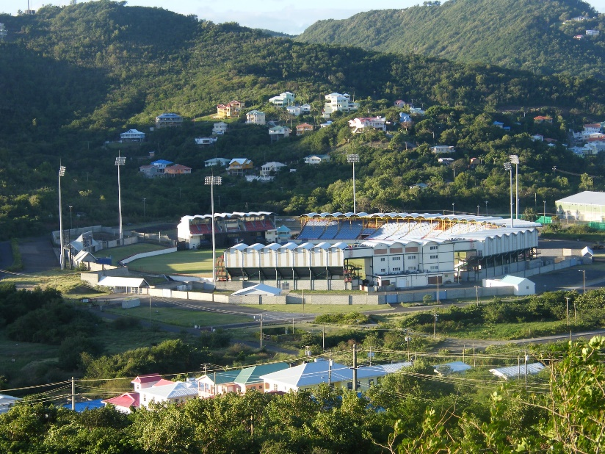
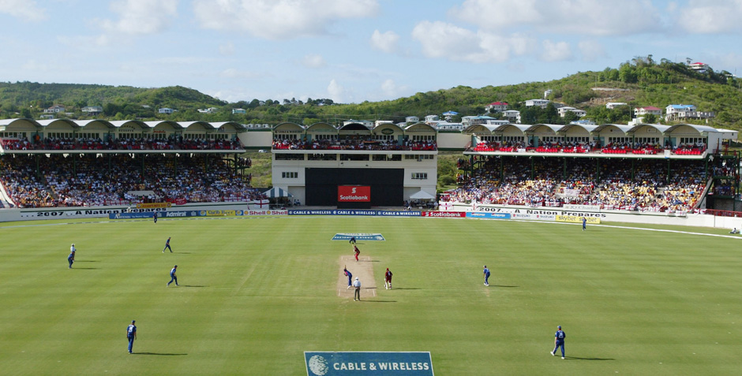
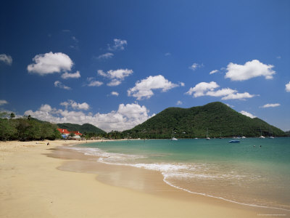
Day 6 – Thursday – 15/02/2017
Match Day 3 & 4 @ The Darren Sammy Stadium (subject to International fixture)
2 x T20 Game
Relax & Evening meal at Resort

Slide 10
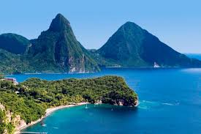
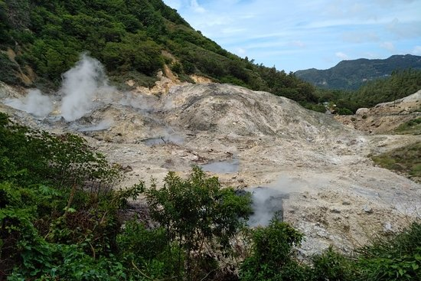
Day 7 – Friday – 16/02/2017
Catarmaran Cruise from Rodney Bay down west coast
Visit to The Pitons (World Heritage Site)
Town of Soufriere - Sulphur Springs - Soufriere Drive-In Volcano - Superman Waterfall
Tour Dinner & Awards

Slide 11
Day 8 – Saturday – 17/02/2017
Morning leisure before Midday check out of hotel
Evening Return Flight to UK from Hewanorra International Airport
Land at Gatwick Airport Sunday morning UK time

